Slide 1

A Machine learning model to predict the likelihood of loan approval
-BY GROUP 5
Ayushi Agarwal
Badal Singh Rathore
Divy Sharma
Neha Dutta
Sukhvir Singh

Slide 2

Problem statement
Develop a machine learning model to predict the likelihood of loan approval based on applicants' information.

Slide 3

Dataset
The dataset is collected from-
https://www.kaggle.com/datasets/rishikeshkonapure/home-loan-approval
The dataset is in csv format.
There are total 615 numbers of rows and 13 columns.
Column names are - Loan_ID, Gender, Married, Dependents, Education, Self_Employed, ApplicantIncome, CoapplicantIncome, LoanAmount, Loan_Amount_Term, Credit_History,Property_Area, Loan_Status.

Slide 4
Data cleaning
There are several column present in the Training Data.csv dataset where null value is present. For removing the null values we replace the null value present in categorical data by “Unknown” and in numerical data by the mean value of that column.

Slide 5
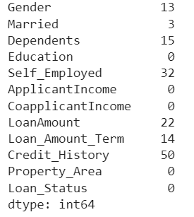
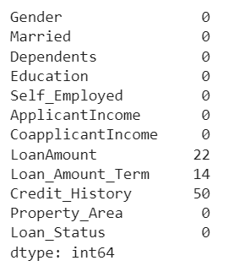
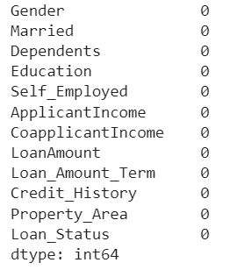
After replacing categorical
Null values
Dataset before data cleaning
After removing all null values

Slide 6
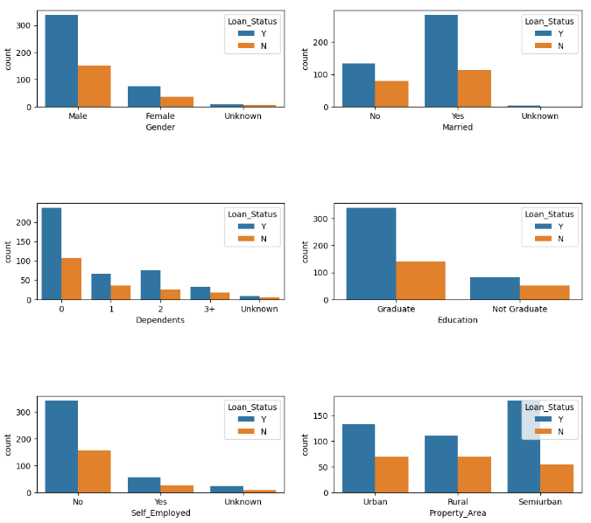
Data visualization

Slide 7
Plots above convey following things about the dataset: Loan Approval Status: About 2/3rd of applicants have been granted loan. Sex: There are more Men than Women (approx. 3x) Martial Status: 2/3rd of the population in the dataset is Marred; Married applicants are more likely to be granted loans. Dependents: Majority of the population have zero dependents and are also likely to accepted for loan. Education: About 5/6th of the population is Graduate and graduates have higher propotion of loan approval Employment: 5/6th of population is not self employed. Property Area: More applicants from Semi-urban and also likely to be granted loans. Applicant with credit history are far more likely to be accepted. Loan Amount Term: Majority of the loans taken are for 360 Months (30 years).

Slide 8
Data splitting & training
We split the dataset as “test_size=0.2” means 20% data will be used for testing purpose and rest 80% for training the model. And we used “random_state=42” to avoid getting different result each time running the program.
Here we used Decision Tree Classifier for training the model.

Slide 9
Accuracy & F1 score
Training Data Set Accuracy: 1.0
Training Data F1 Score 1.0
Validation Mean F1 Score: 0.6460137513653038
Validation Mean Accuracy: 0.6883323026180168
We can see from above metrics that Training Accuracy > Test Accuracy with default settings of Decision Tree classifier. Hence, model is overfit. We will try some Hyper-parameter tuning and see if it helps.

Slide 10
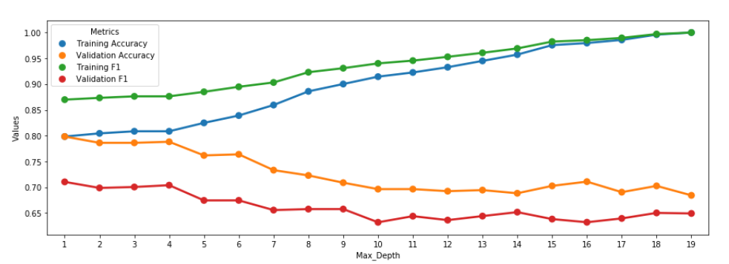
Changing depth of Decision tree
From the graph we can conclude that keeping 'Max_Depth' = 3 will yield optimum Test accuracy and F1 score Optimum Test Accuracy ~ 0.805; Optimum F1 Score: ~0.7

Slide 11
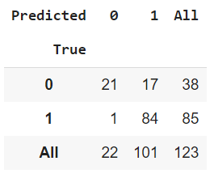
Precision Recall
True Positive (TP): 85
False Positive (FP): 17
True Negative (TN): 21
False Negative (FN): 1
Precision Score = TP / (FP + TP)
= 85/(17 + 85)
=0.833
Recall Score = TP / (FN + TP)
=85/ (1+85)
=0.98
Precision measures the accuracy of positive predictions, while recall measures the completeness of positive predictions. Higher precision means that an algorithm returns more relevant results than irrelevant ones, and high recall means that an algorithm returns most of the relevant results (whether or not irrelevant ones are also returned).

Slide 12
summary
Upon collecting the dataset of loan approval data we removed the null values. Then visualization the data from different perspectives ( categorical and numerical) we get a brief idea how these fields effect on a loan application to be approved. Then splitting the dataset into 2 parts (training & testing) we train the data using Decision tree classifier.
Upon getting Training Accuracy > Test Accuracy it is understood model is overfit. For making that correct we tried some Hyper-parameter tuning. And at max depth = 3 we get a optimal value.

Slide 13




Thank you

